Slide 1
FIFA MANAGEMENT SYSTEM
Presented By:
Shruti Bindal (191500791)
Chetan Singh (191500227)

Slide 2
OUTLINE
About the Project
Objectives
Requirements
Snapshots of the website

Slide 3
About The Project
This project consists of player details, which describes about player biodata such as age and nationality. It also consists of player stats which describes about players technical skills. It also consists of tables containing details such as player earnings, club information and preferred position of playing. It also provide a strong searching, updating, deleting and inserting operations with a user friendly web based UI.
The project also helps the users to keep track of the player details in a computerized way without any trouble. The project contains 7 stored procedures and 3 triggers per table. Stored procedures are used in search engine. Every time the user searches through the database, a procedure is called and the results is collected and displayed for the user in a structured manner. It also has 3 trigger namely “Insert, Delete and Update” triggers assigned separately to each table. Whenever operations such as insert or delete or update is performed on any table, these triggers are automatically called, and the logs are captured into 3 separate tables, individually for each trigger. Hence use of triggers provides users to trace back all the latest as well as the oldest changes into any table at any point of time.
This project is a simple prototype of managing larger numbers of players across different nations with different skill sets and attributes. It helps to access players and thus aids in building a strong positional team. It also helps in monitoring player growth.

Slide 4
Objective
The project titled “FIFA Management System” is player management software for monitoring and accessing players based on their FIFA PC/XBOX Game ratings. It focuses on basic operation like adding a new player, new statistics, searching players with detailed information and edit as they grow their skills.
This project is a web based application designed and developed to help user’s access players and organize teams. This software is easy to use, and it features a familiar and well- thought-out attractive user interface, combined with strong searching, insertion, and deletion with procedure capabilities. Analyzing players have been a huge task performed by professional scouting agents who are spread around the world. From personal details to football technicalities, FIFA Management system allows easy maintenance record of such skilled youth talent.

Slide 5
Software Requirements
Windows/Linux Operating System
Visual Studio Code
XAMP

Slide 6
Hardware Requirements
Computer Systems with minimum 8GB of RAM.
Processor Required: Intel i3, i5, i7 or i9.
Operating System: Windows 8/10 , Linux
Web Browser: Google Chrome, Microsoft Edge etc.

Slide 7
Programming Languages Used :
HTML5
CSS3
JAVASCRIPT
PHP
SQL

Slide 8
The Look of the Website :-

Slide 9
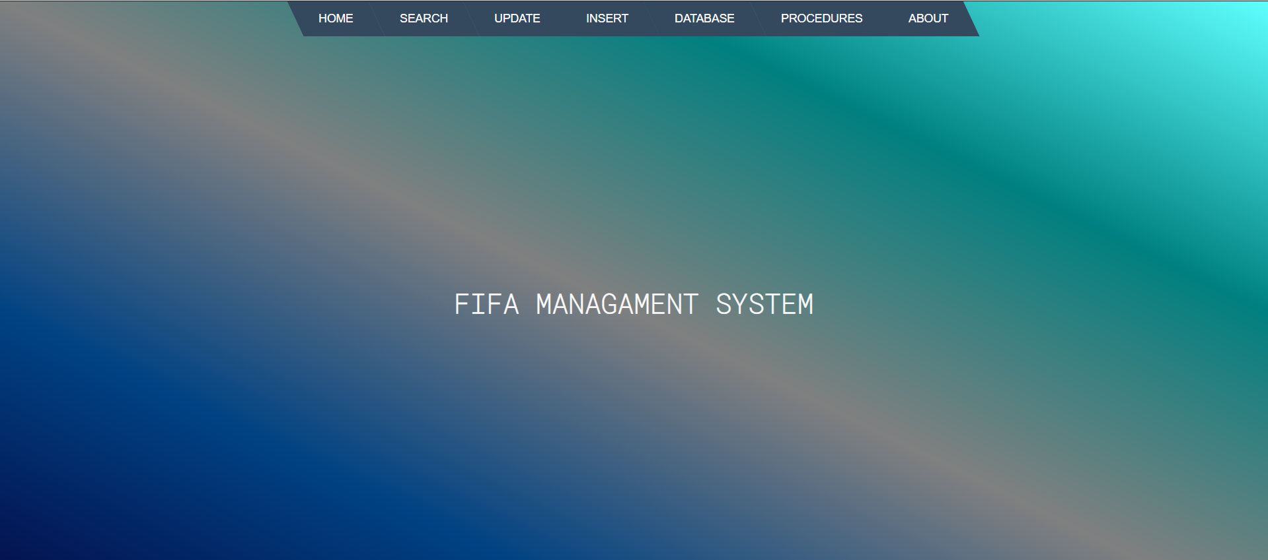
Home Page
This is a Home page of a website from where we can navigate to other pages of the website.

Slide 10
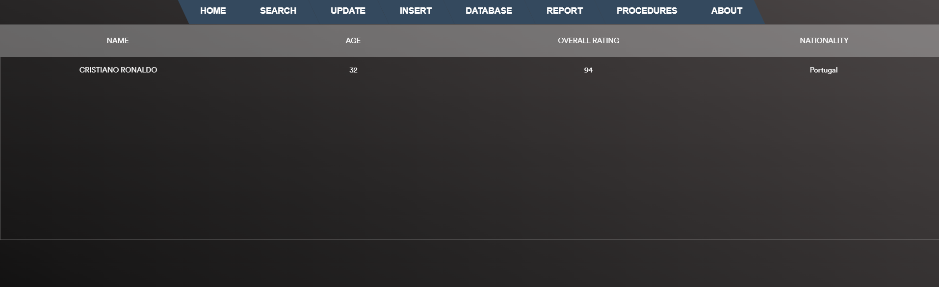
Search Data Page
In this page, we can search any record of a player by its name, age etc.

Slide 11
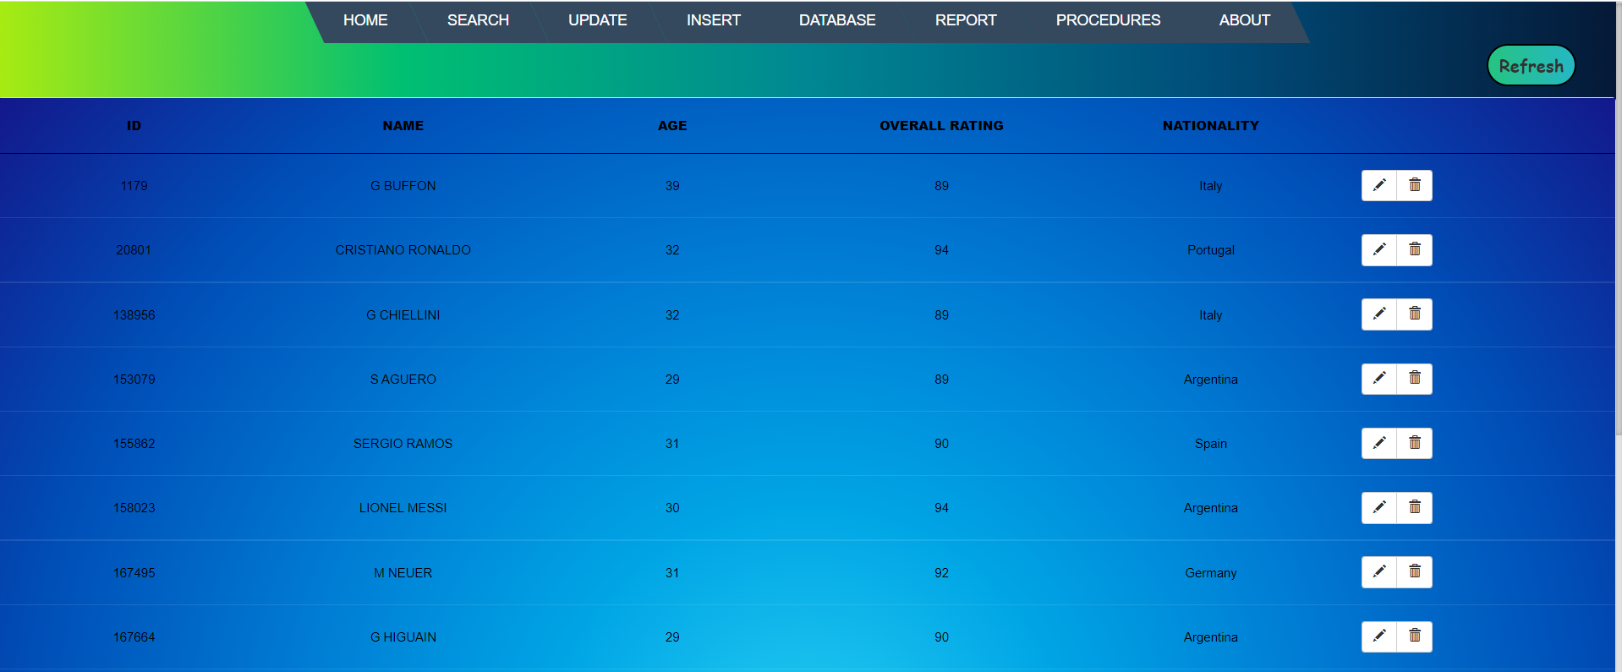
Update Data Page
In this page, we can modify or delete any record of players by their name, age etc.

Slide 12

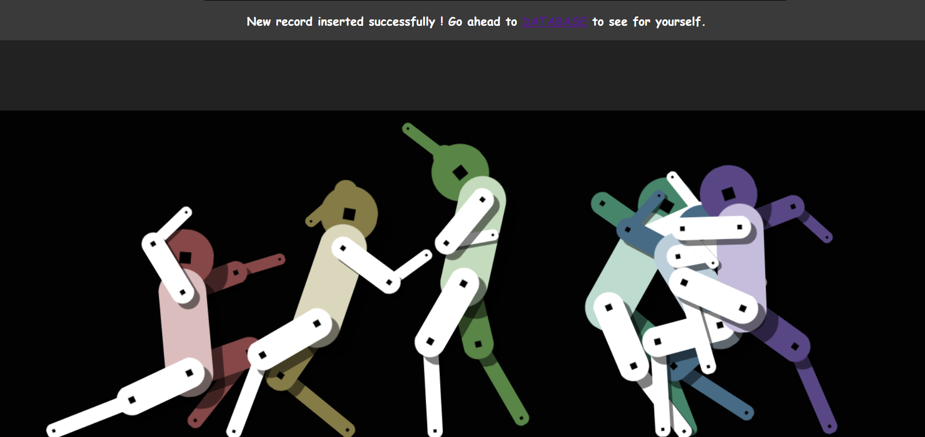
Insert Data Page
In this page, we can insert new records in our database.

Slide 13
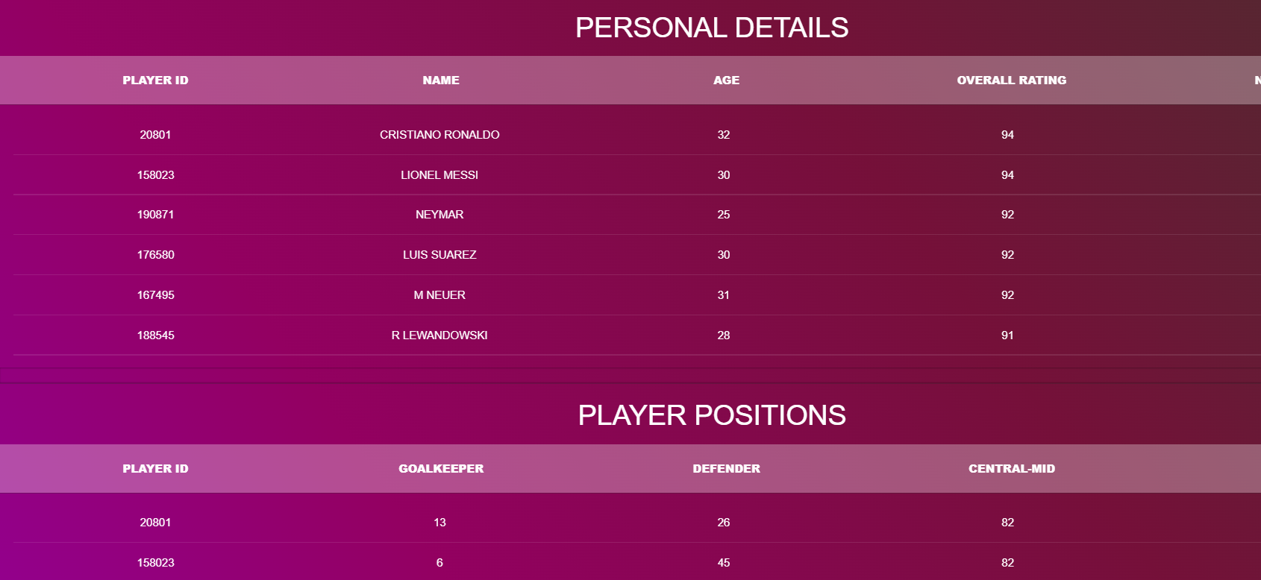
Database Page
This page stores the database of the website.

Slide 14
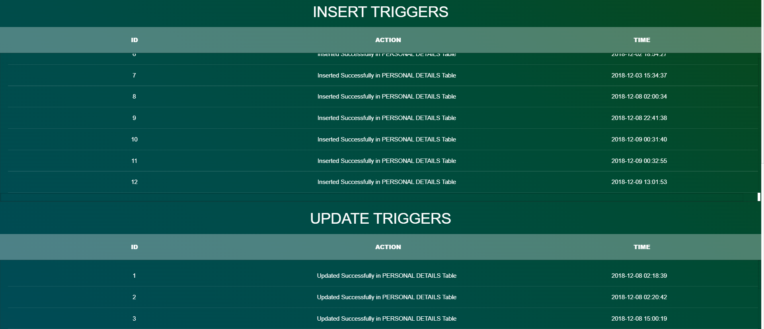
Procedures Page
This page shows the list of various triggers such as insert, update and delete.

Slide 15
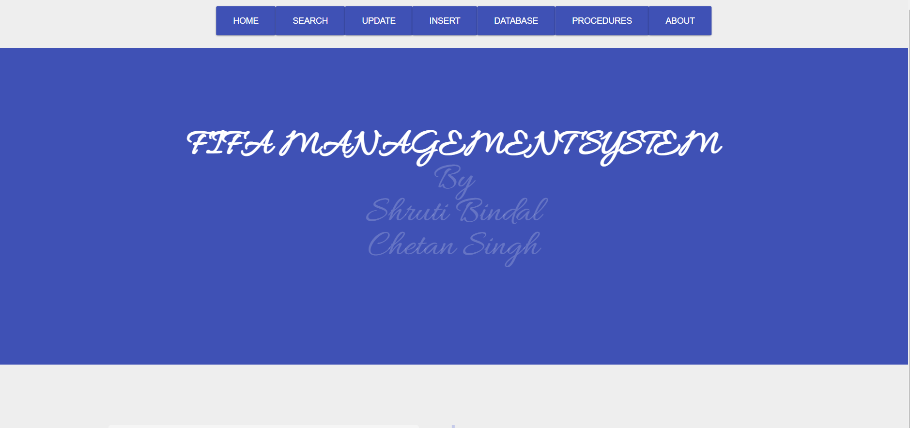
About Page
This page gives the description about the project as well as the links to contact the developer of the project in case of some issue.

Slide 16
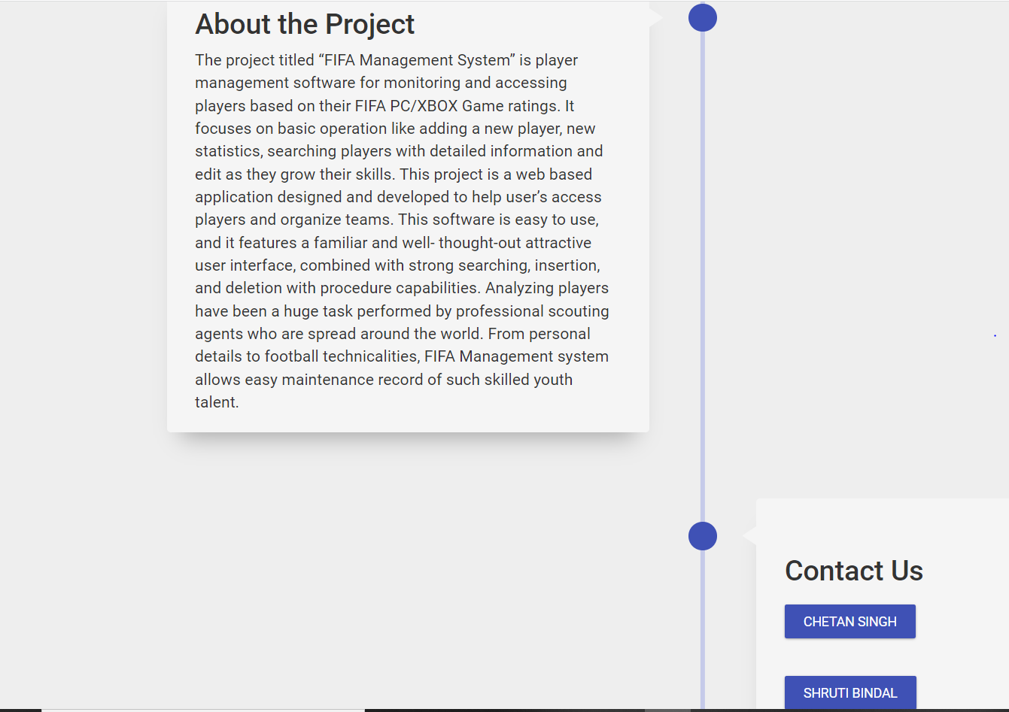

Slide 17
Thank You !!

